Slide 1
Chapter 4
Advanced Internetworking
Copyright © 2010, Elsevier Inc. All rights Reserved
Notes:
The University of Adelaide, School of Computer Science
Chapter 2 — Instructions: Language of the Computer

Slide 2
Problems
How do we build a routing system that can handle hundreds of thousands of networks and billions of end nodes?
How to handle address space exhaustion of IPV4?
How to enhance the functionalities of Internet?
Notes:
The University of Adelaide, School of Computer Science
Chapter 2 — Instructions: Language of the Computer

Slide 3
Chapter Outline
Global Internet
Multicast
Mobile IP
Notes:
The University of Adelaide, School of Computer Science
Chapter 2 — Instructions: Language of the Computer

Slide 4
Chapter Goal
Understanding the scalability of routing in the Internet
Discussing IPv6
Understanding the concept of multicasting
Discussing Mobile IP
Notes:
The University of Adelaide, School of Computer Science
Chapter 2 — Instructions: Language of the Computer

Slide 5
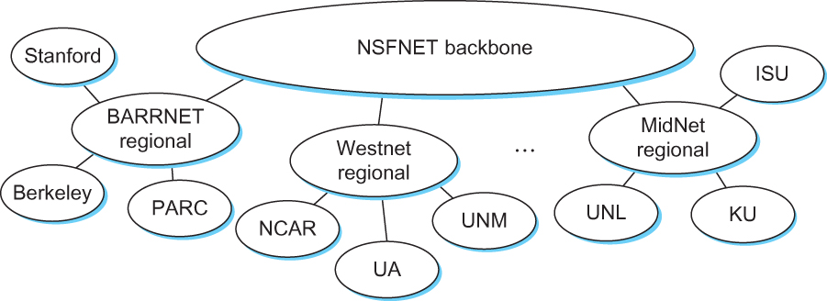
The Global Internet
The tree structure of the Internet in 1990
Notes:
The University of Adelaide, School of Computer Science
Chapter 2 — Instructions: Language of the Computer

Slide 6
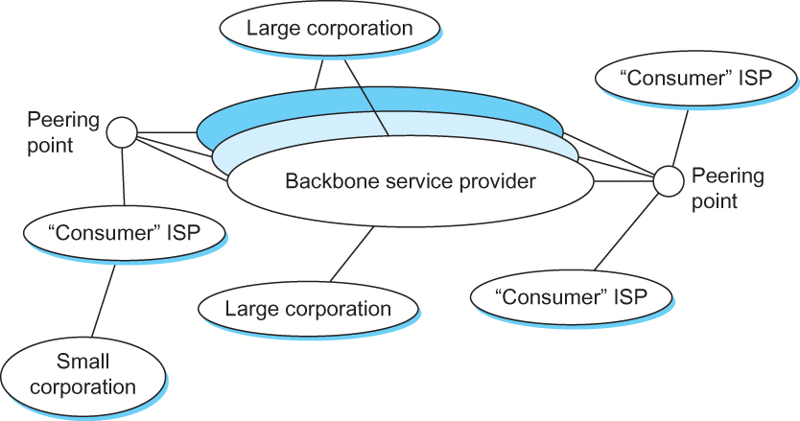



The Global Internet
A simple multi-provider Internet
Notes:
The University of Adelaide, School of Computer Science
Chapter 2 — Instructions: Language of the Computer

Slide 7

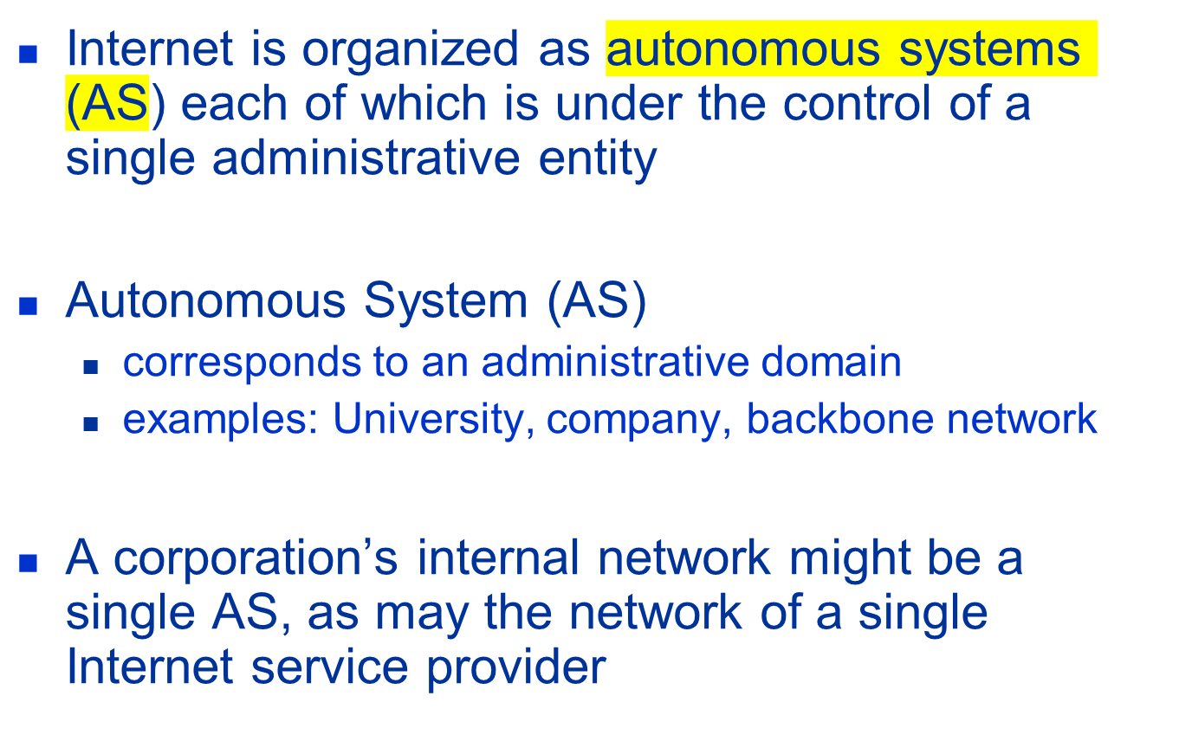



Slide 8

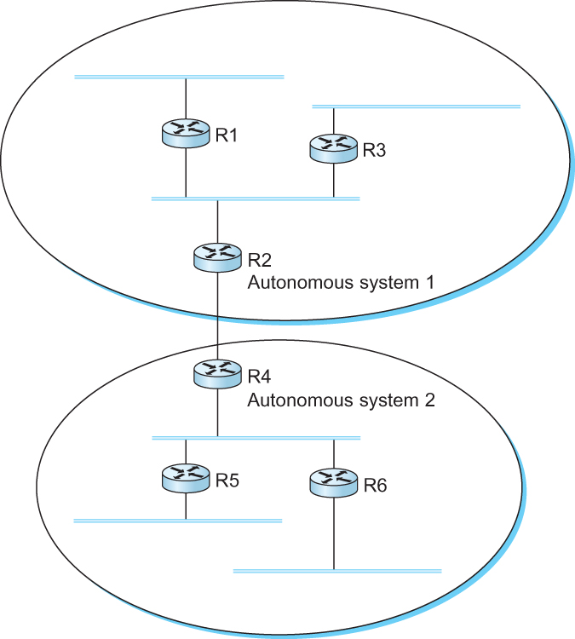


A network with two autonomous system

Slide 9
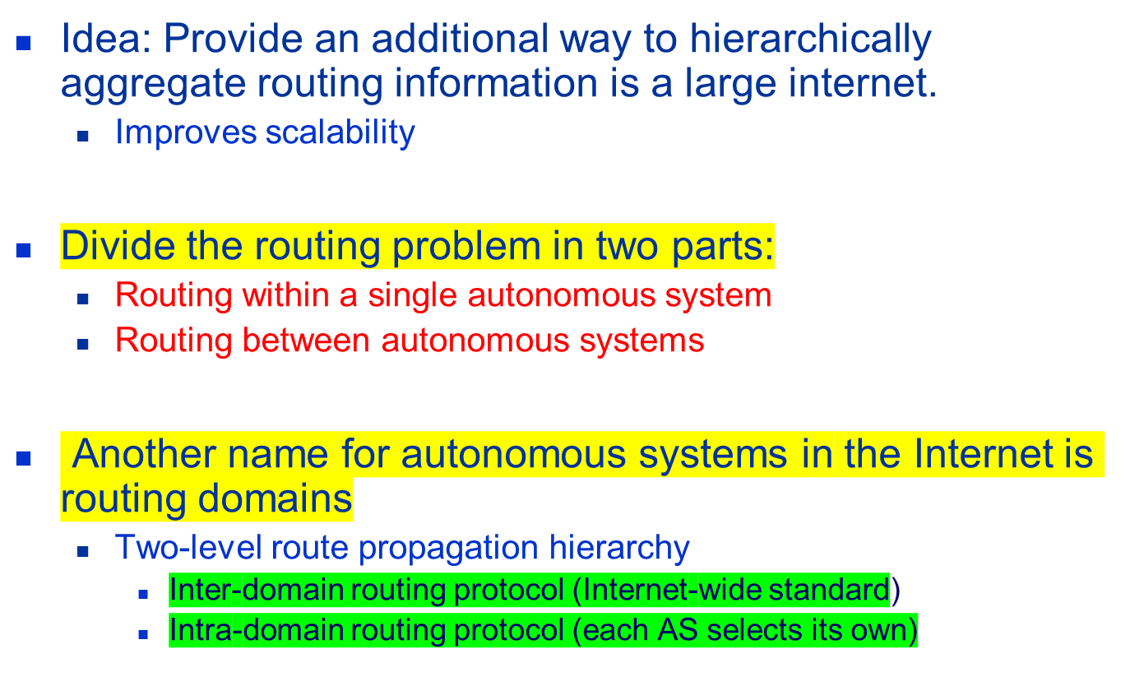
Route Propagation

Slide 10
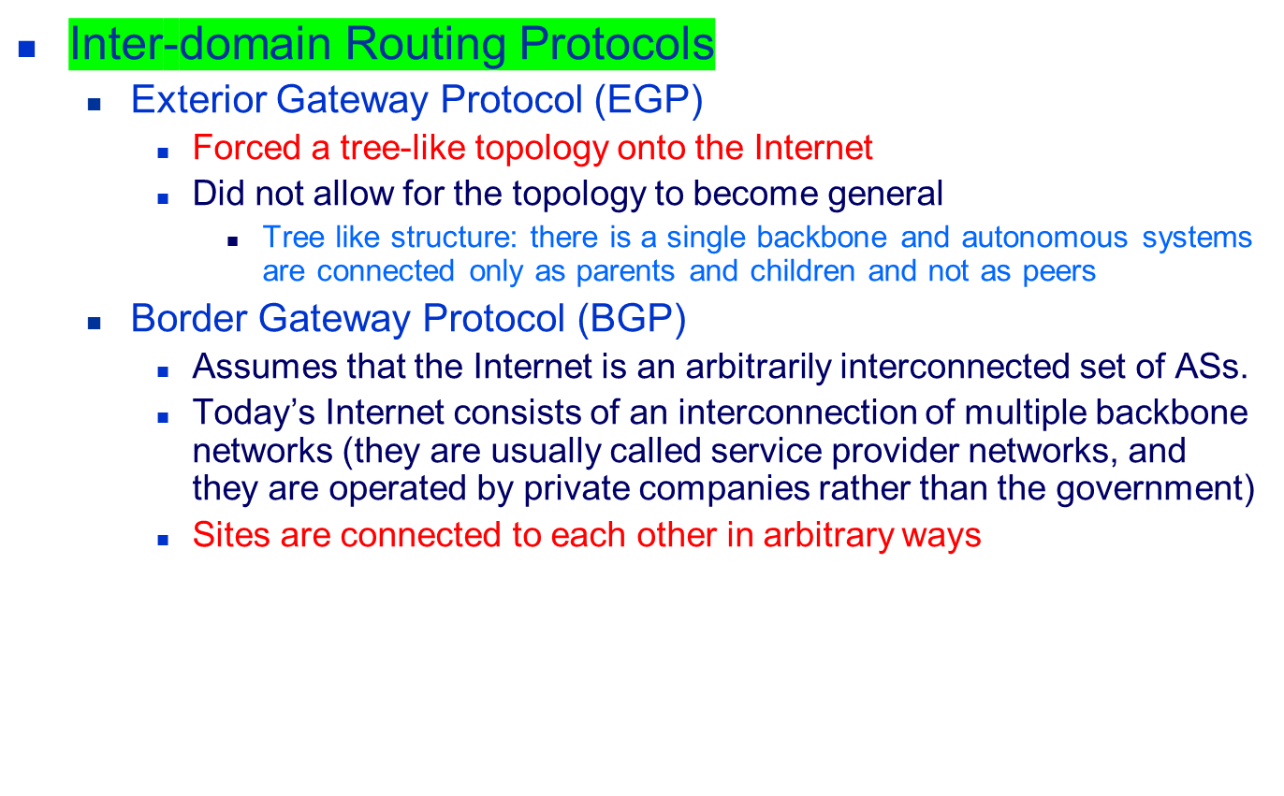
EGP and BGP

Slide 11
BGP
Some large corporations connect directly to one or more of the backbone, while others connect to smaller, non-backbone service providers.
Many service providers exist mainly to provide service to “consumers” (individuals with PCs in their homes), and these providers must connect to the backbone providers
Often many providers arrange to interconnect with each other at a single “peering point”

Slide 12
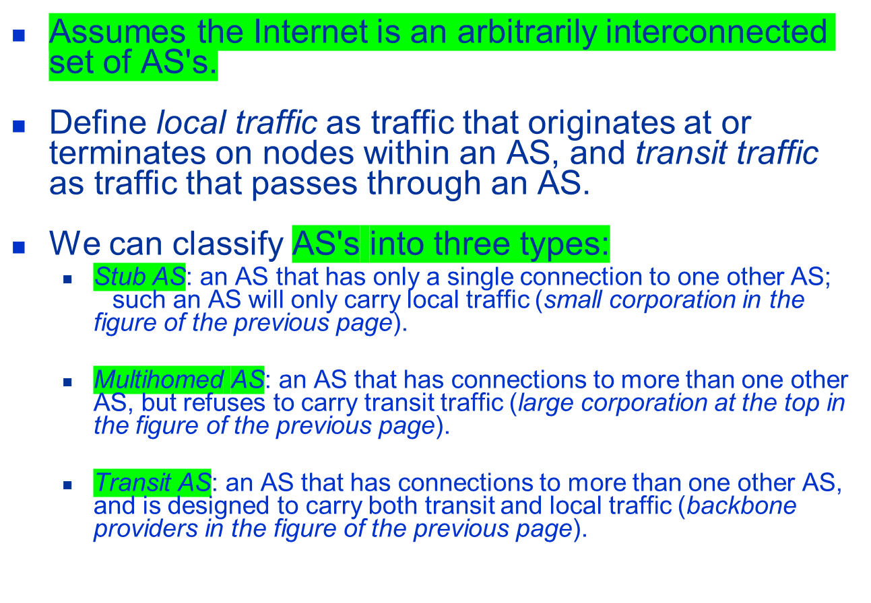
BGP-4: Border Gateway Protocol

Slide 13
BGP
The goal of Inter-domain routing is to find any path to the intended destination that is loop free
  We are concerned with reachability than optimality
  Finding path anywhere close to optimal is considered to be a great achievement
Why?

Slide 14



BGP
Scalability: An Internet backbone router must be able to forward any packet destined anywhere in the Internet
  Having a routing table that will provide a match for any valid IP address
Autonomous nature of the domains
  It is impossible to calculate meaningful path costs for a path that crosses multiple ASs
  A cost of 1000 across one provider might imply a great path but it might mean an unacceptable bad one from another provid
Issues of trust
  Provider A might be unwilling to believe certain advertisements from provider B

Slide 15
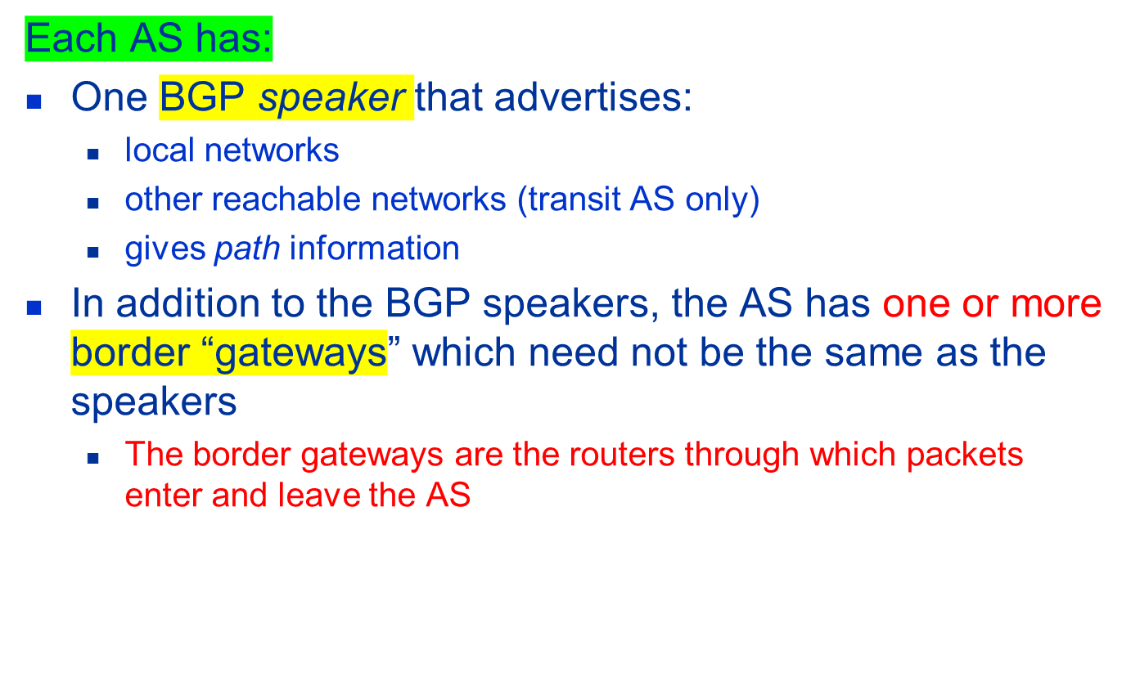
BGP

Slide 16
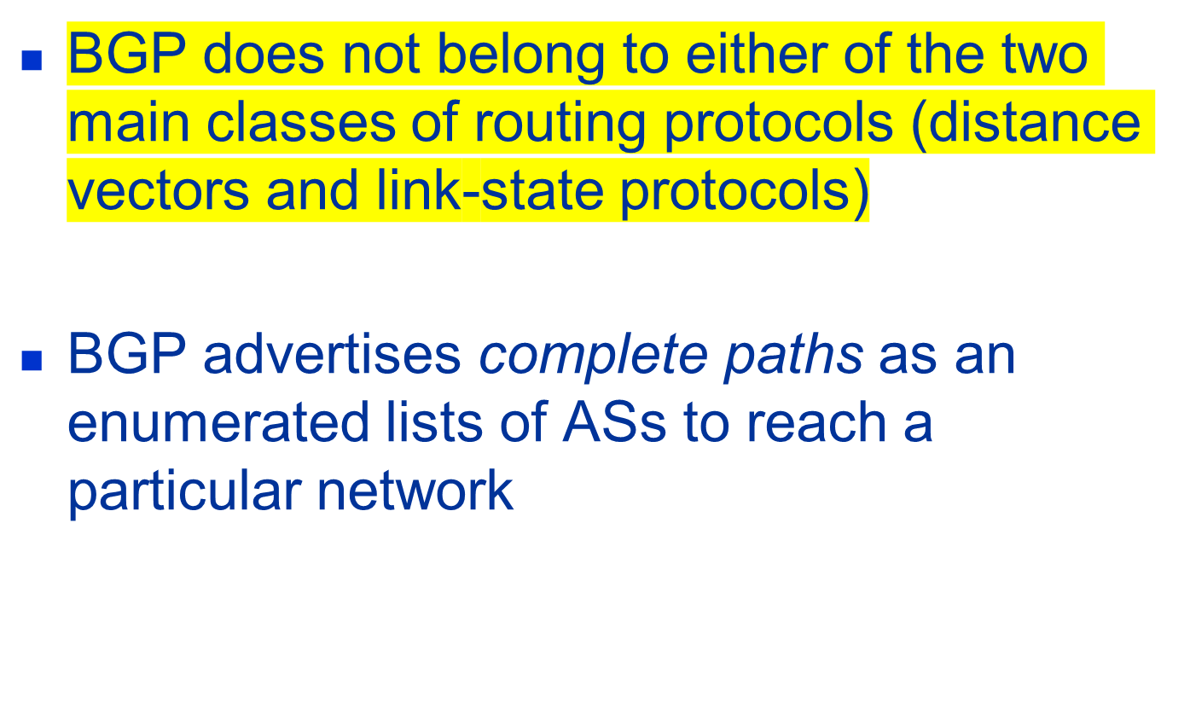
BGP

Slide 17


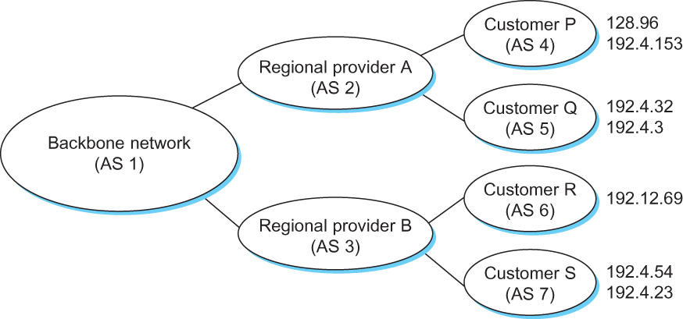
BGP Example
Example of a network running BGP

Slide 18
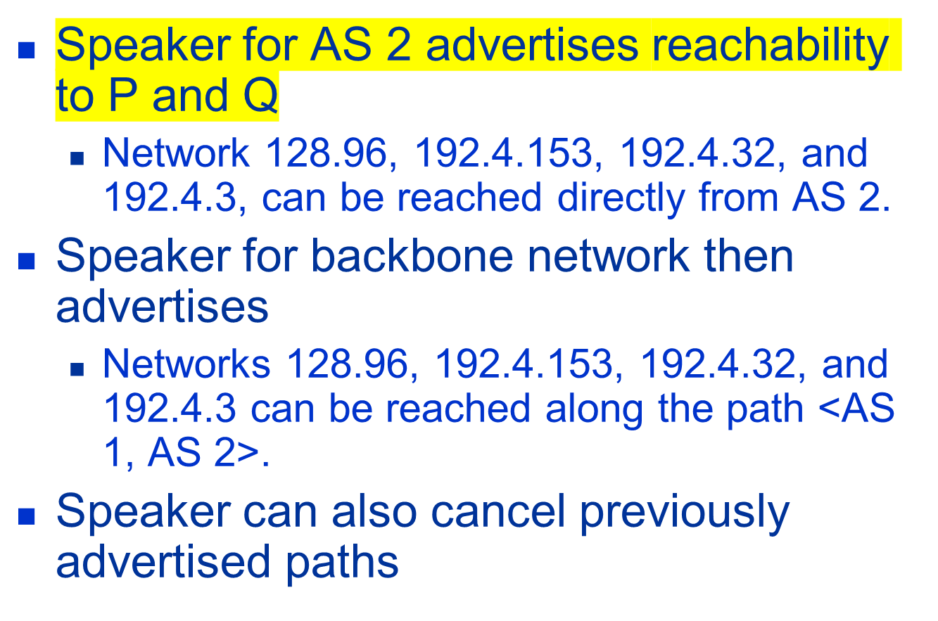
BGP Example

Slide 19
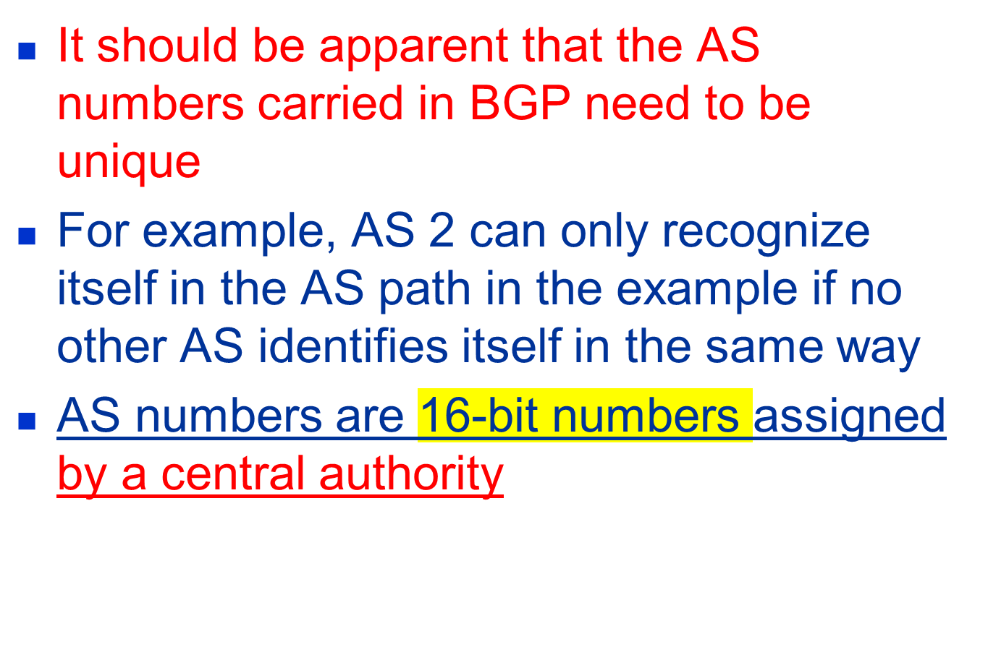
BGP Issues

Slide 20
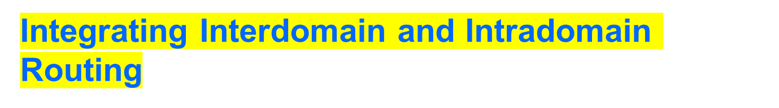
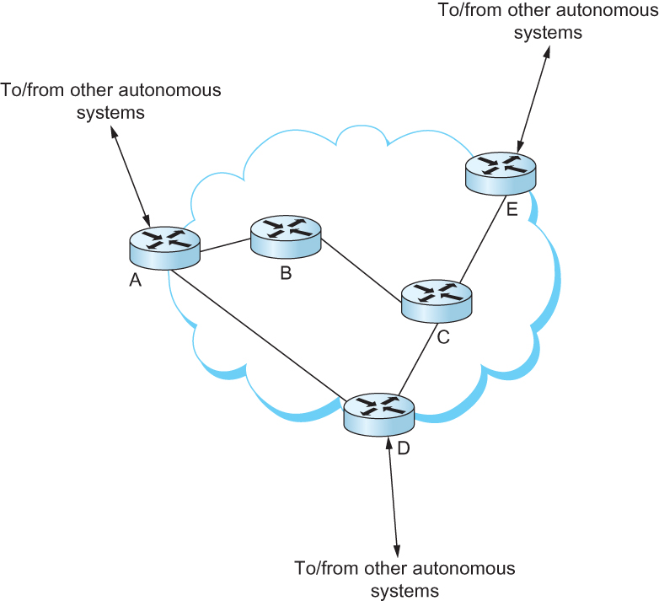
All routers run iBGP and an intradomain routing protocol. Border routers (A, D, E) also run eBGP to other ASs

Slide 21
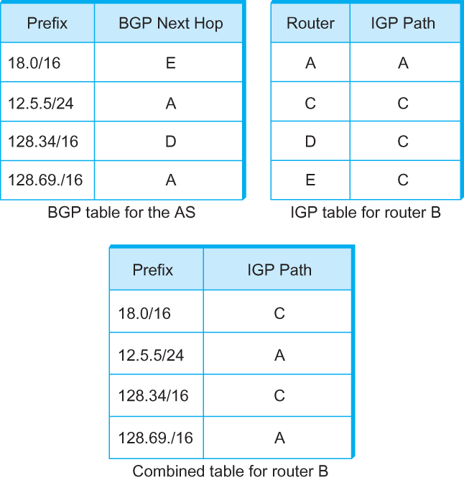
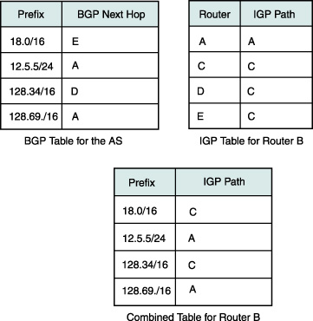
Integrating Interdomain and Intradomain Routing
BGP routing table, IGP routing table, and combined table at router B

Slide 22
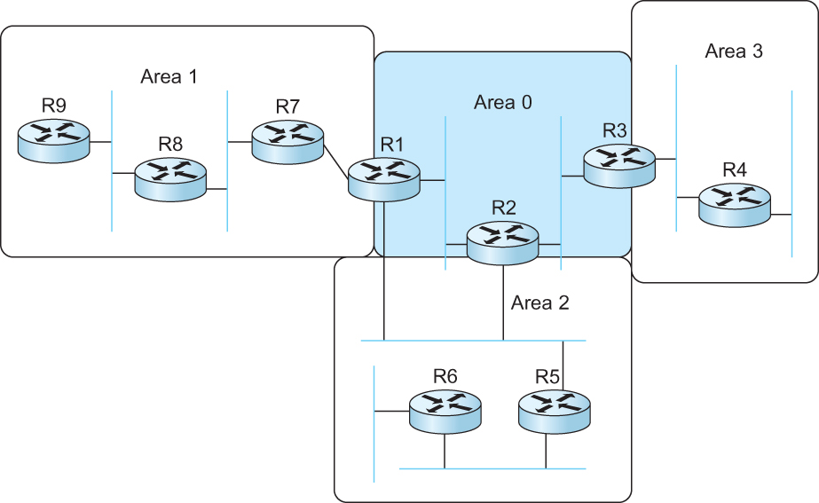
Routing Areas
Backbone area
Area border router (ABR)
A domain divided into area

Slide 23
Next Generation IP (IPv6)

Slide 24
Major Features
128-bit addresses
Multicast
Real-time service
Authentication and security
Auto-configuration
End-to-end fragmentation
Enhanced routing functionality, including support for mobile hosts

Slide 25
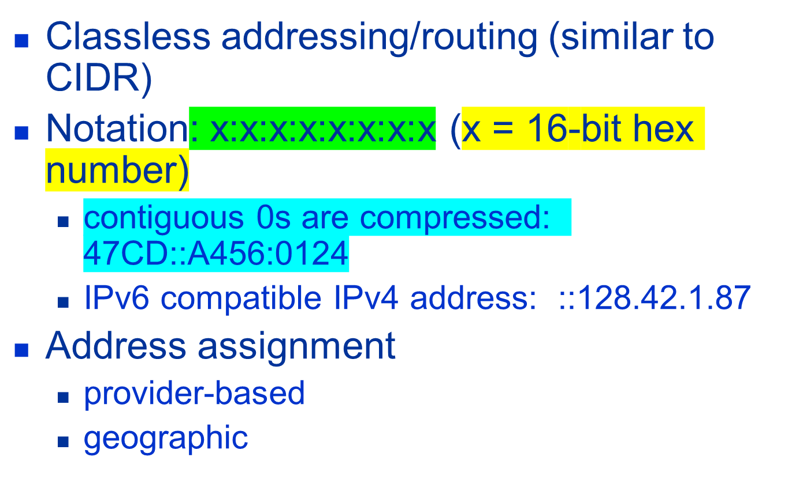



IPv6 Addresses

Slide 26
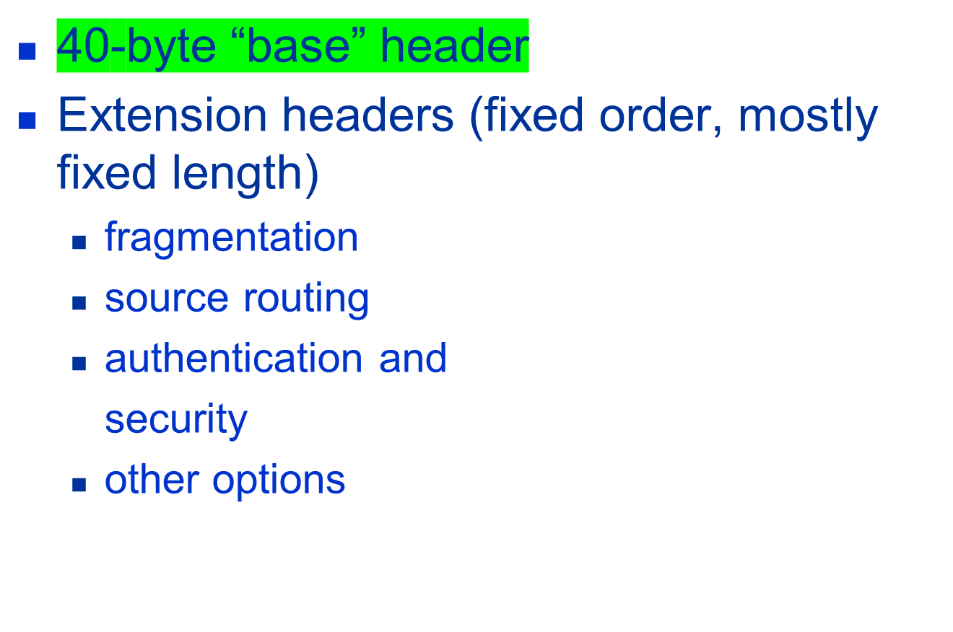
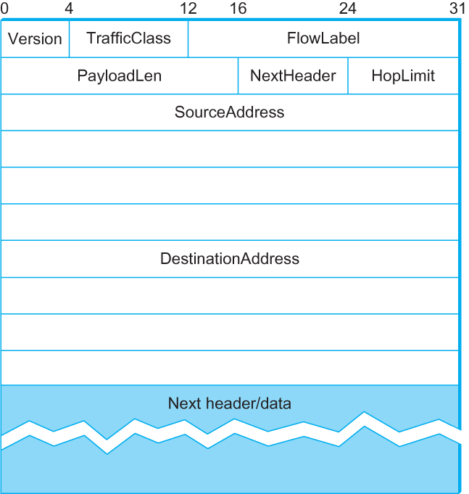
IPv6 Header

Slide 27
Internet Multicast

Slide 28
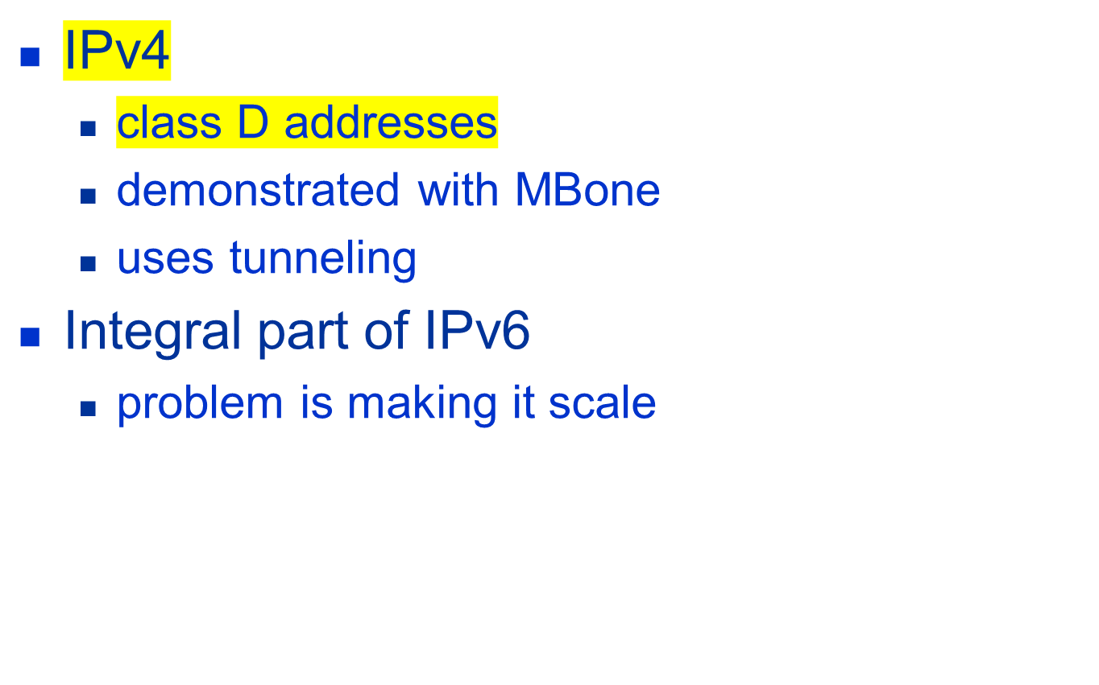
Overview

Slide 29
Overview
One-to-many
  Radio station broadcast
  Transmitting news, stock-price
  Software updates to multiple hosts
Many-to-many
  Multimedia teleconferencing
  Online multi-player games
  Distributed simulations

Slide 30
Overview
Without support for multicast
  A source needs to send a separate packet with the identical data to each member of the group
    This redundancy consumes more bandwidth
    Redundant traffic is not evenly distributed, concentrated near the sending host
  Source needs to keep track of the IP address of each member in the group
    Group may be dynamic
To support many-to-many and one-to-many IP provides an IP-level multicast

Slide 31
Overview
Basic IP multicast model is many-to-many based on multicast groups
  Each group has its own IP multicast address
  Hosts that are members of a group receive copies of any packets sent to that group’s multicast address
  A host can be in multiple groups
  A host can join and leave groups

Slide 32
Overview
Using IP multicast to send the identical packet to each member of the group
  A host sends a single copy of the packet addressed to the group’s multicast address
  The sending host does not need to know the individual unicast IP address of each member
  Sending host does not send multiple copies of the packet

Slide 33
Overview
IP’s original many-to-many multicast has been supplemented with support for a form of one-to-many multicast
One-to-many multicast
  Source specific multicast (SSM)
  A receiving host specifies both a multicast group and a specific sending host
Many-to-many model
  Any source multicast (ASM)

Slide 34
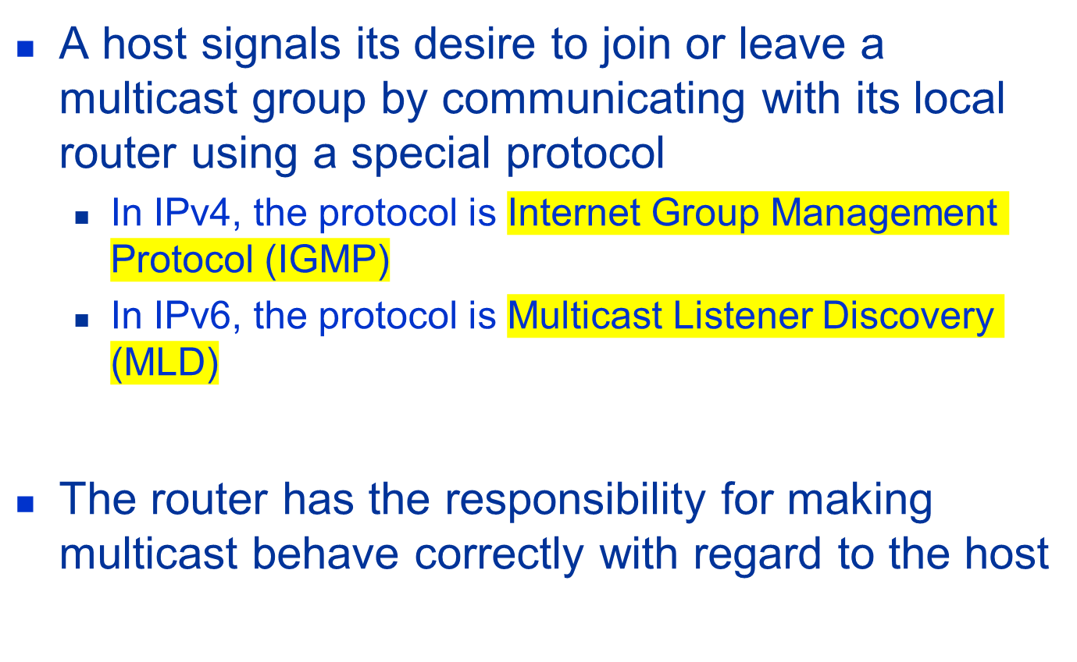
Overview

Slide 35
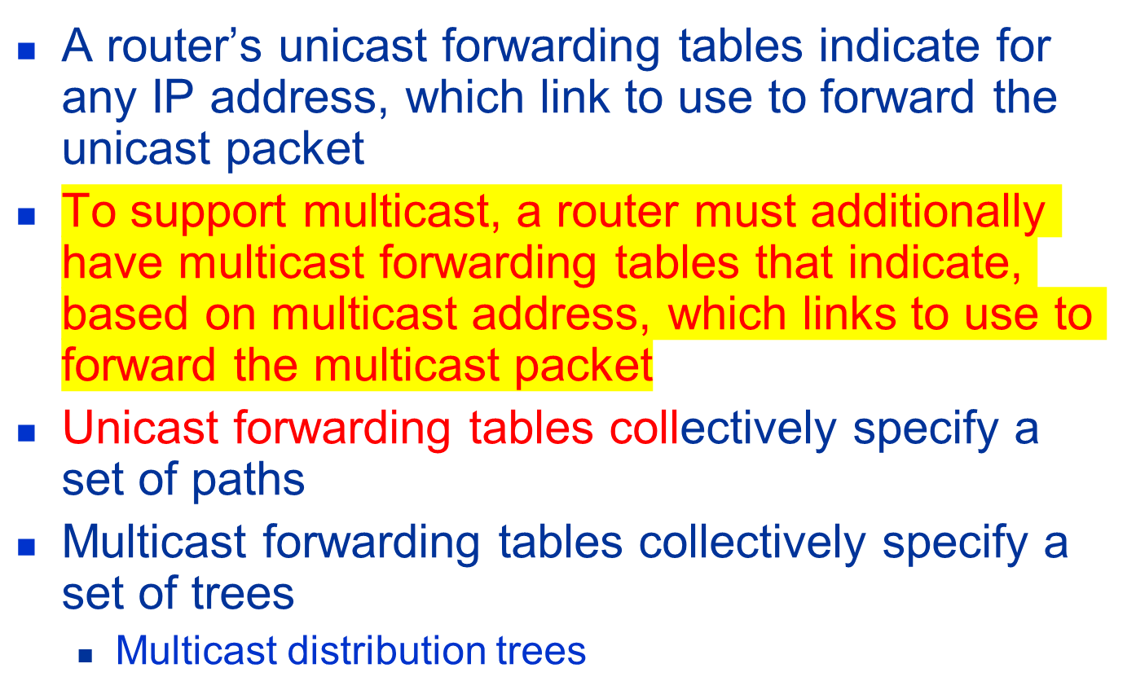
Multicast Routing

Slide 36
Multicast Routing
To support source specific multicast, the multicast forwarding tables must indicate which links to use based on the combination of multicast address and the unicast IP address of the source
Multicast routing is the process by which multicast distribution trees are determined

Slide 37
Distance-Vector Multicast
Each router already knows that shortest path to source S goes through router N.
When receive multicast packet from S, forward on all outgoing links (except the one on which the packet arrived), iff packet arrived from N.
Eliminate duplicate broadcast packets by only letting
  “parent” for LAN (relative to S) forward
    shortest path to S (learn via distance vector)
    smallest address to break ties

Slide 38
Distance-Vector Multicast
Reverse Path Broadcast (RPB)
Goal: Prune networks that have no hosts in group G
Step 1: Determine of LAN is a leaf with no members in G
  leaf if parent is only router on the LAN
  determine if any hosts are members of G using IGMP
Step 2: Propagate “no members of G here” information
  augment <Destination, Cost> update sent to neighbors with set of groups for which this network is interested in receiving multicast packets.
  only happens when multicast address becomes active.

Slide 39
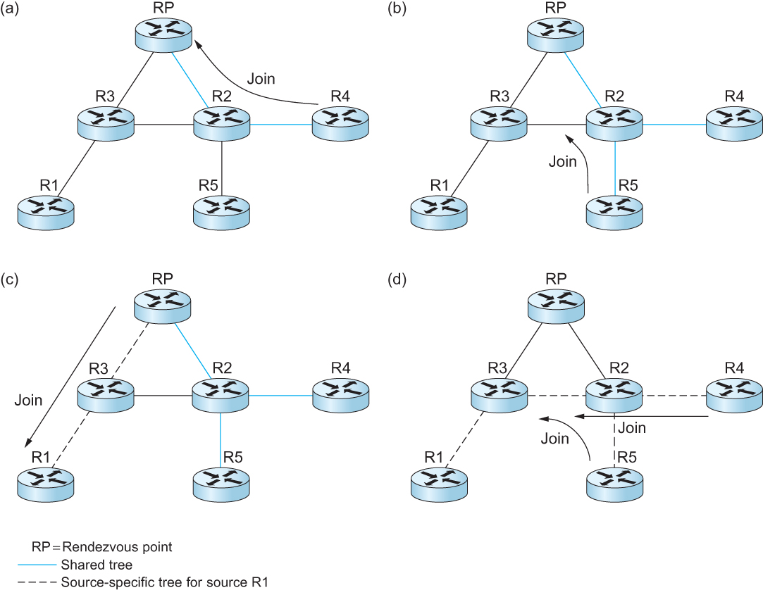
Protocol Independent Multicast (PIM)
Shared Tree
Source specific tree

Slide 40
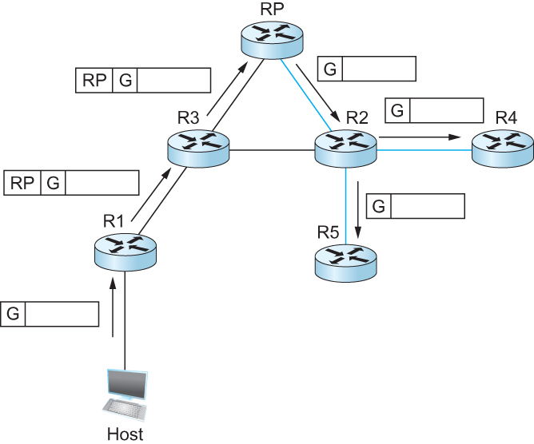
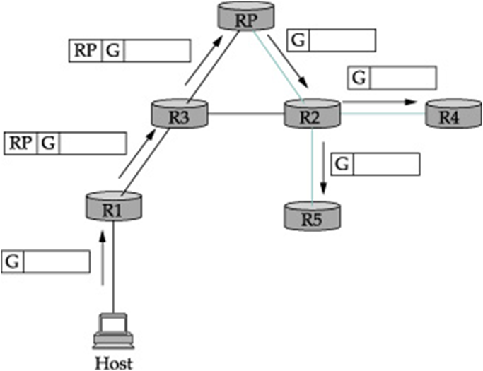
Protocol Independent Multicast (PIM)
Delivery of a packet along a shared tree. R1 tunnels the packet to the RP, which forwards it along the shared tree to R4 and R5.

Slide 41
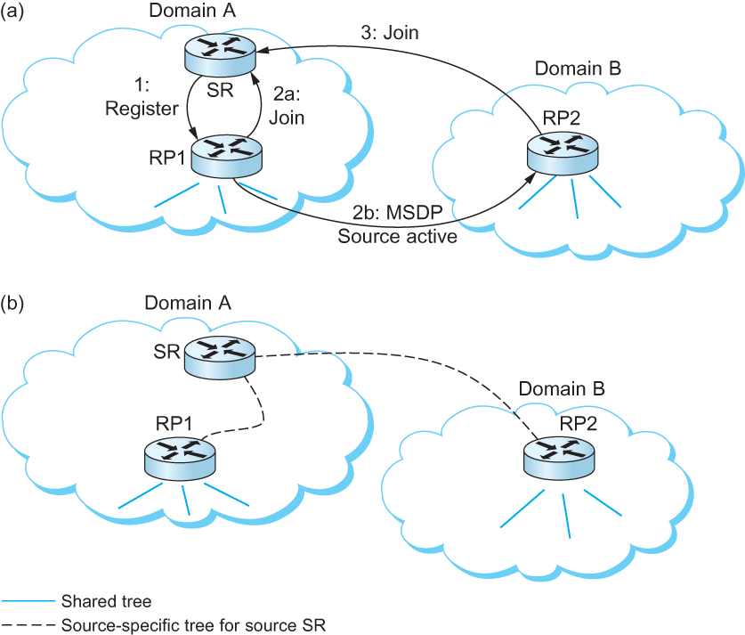
Inter-domain Multicast
Multicast Source Discovery Protocol (MSDP)

Slide 42
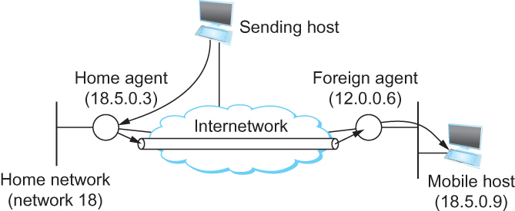
Routing for Mobile Hosts
Mobile IP
  home agent
    Router located on the home network of the mobile hosts
  home address
    The permanent IP address of the mobile host.
    Has a network number equal to that of the home network and thus of the home agent
  foreign agent
    Router located on a network to which the mobile node attaches itself when it is away from its home network

Slide 43
Routing for Mobile Hosts
Problem of delivering a packet to the mobile node
  How does the home agent intercept a packet that is destined for the mobile node?
    Proxy ARP
  How does the home agent then deliver the packet to the foreign agent?
    IP tunnel
    Care-of-address
  How does the foreign agent deliver the packet to the mobile node?

Slide 44
Routing for Mobile Hosts
Route optimization in Mobile IP
  The route from the sending node to mobile node can be significantly sub-optimal
  One extreme example
    The mobile node and the sending node are on the same network, but the home network for the mobile node is on the far side of the Internet
      Triangle Routing Problem
  Solution
    Let the sending node know the care-of-address of the mobile node. The sending node can create its own tunnel to the foreign agent
    Home agent sends binding update message
    The sending node creates an entry in the binding cache
    The binding cache may become out-of-date
      The mobile node moved to a different network
      Foreign agent sends a binding warning message

Slide 45
Summary
# Chapter Subtitle
We have looked at the issues of scalability in routing in the Internet
We have discussed IPV6
We have discussed Multicasting
We have discussed Mobile IP
Notes:
The University of Adelaide, School of Computer Science
Chapter 2 — Instructions: Language of the Computer

